Slide 1
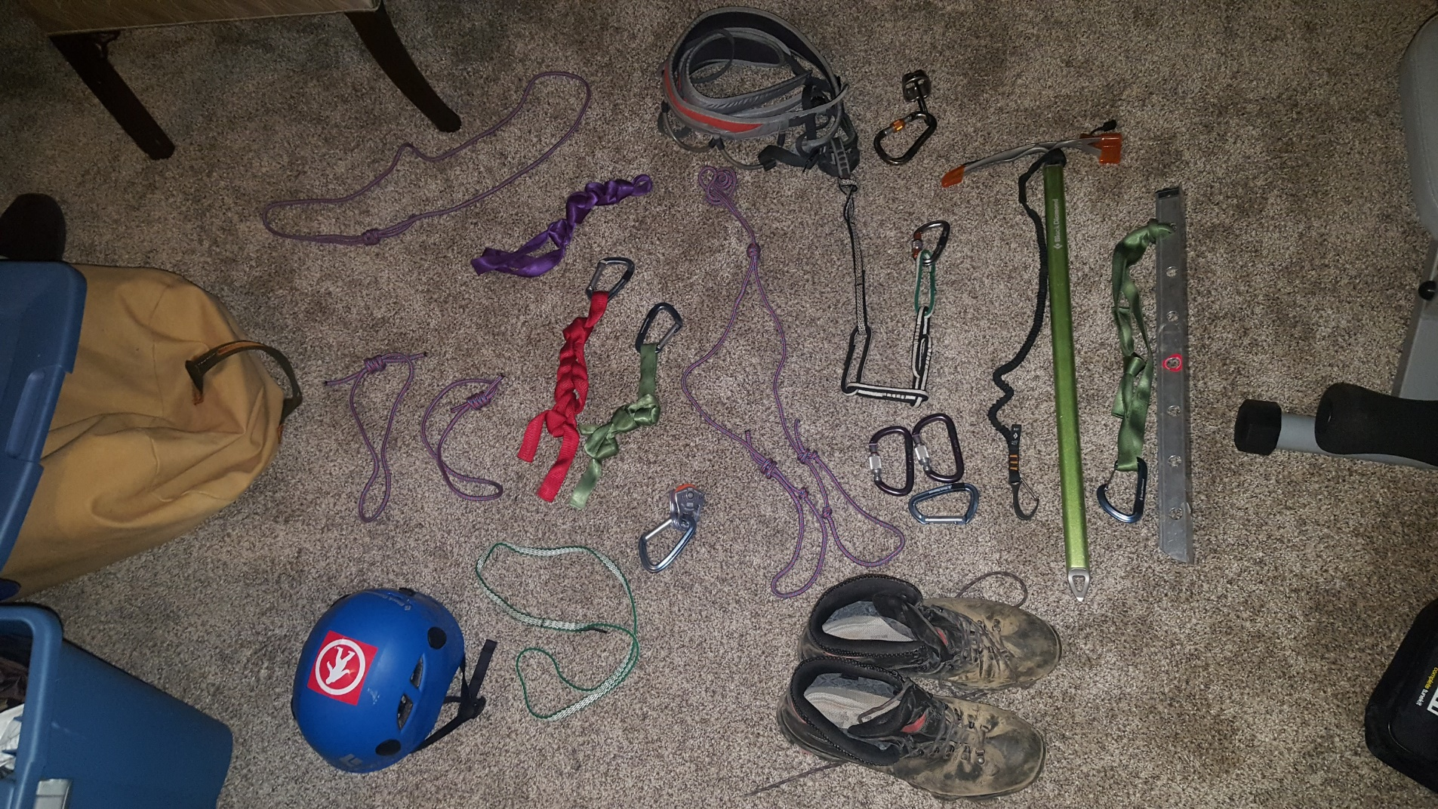
Chest harness
Harness
Belay Device+ pear-shaped locking carabiner
Personal Anchor + small locking carabiner
Chest prusik
2 “hero” loops
Axe leash
Picket + runner + wire-gate carabiner
2 large locking carabiners, extra non-locking carabiner
Runners + carabiners
Rescue Pulley
Foot prusik

